Slide 1
Determinants of Consumer Willingness to Purchase for Organic Products in Thailand
Parichard Sangkumchaliang and Wen-Chi Huang
21st Annual IFAMA World Forum and Symposium
The Road to 2050: Sustainability as a Business Opportunity
Frankfurt, Germany June 20, 2011, Frankfurt Marriott Hotel

Slide 2
Contents
Introduction
Objectives
Methodology
Results
Conclusions
Acknowledgement

Slide 3
Introduction
Organic products are food produced without artificial fertilizer or chemical pesticides, nor containing artificial coloring, flavoring or aromatic substances, preservatives, or genetically modified ingredients.
The interest of consumers and public institution in organically produced foods has increased in response to consumers’ concerns about food safety, human health and the environment
(Willer and Yussefi, 2007; Gracia and Magistris, 2007; Tsakiridou et al., 2008)

Slide 4

Introduction
As people in Thailand the world have become more health-conscious and concerned about the environment, the demand for organic food has risen accordingly.
(IPM DANIDA, 2003; Schobesberger et al., 2008)

Slide 5
Organic agriculture in Thailand
6.25 Rai ≈ 1 Hectare
Rai
Figure 1. Organic Production Area in Thailand
Panyakul, 2009
5

Slide 6



Table 1. Standards and Certification in Thailand
Introduction
Introduction
Organic Food Labels
 | Organic Thailand
 | Organic Agriculture Certification Thailand
 | The Northern Organic Standard Organization
 | International Foundation of Organic Agriculture Movements
(IPMDANIDA, 2003; Schobesberger et al., 2008; Wyatt, 2009)

Slide 7
Objectives
The aim of this study is to understand the determinants related to the consumer behavior on organic food:
To collect the detailed information of the demographic characteristics and the purchasing habit of the organic consumer in Chiang Mai City.
Identifies the factors that affect consumers’ behavior towards organic food products.

Slide 8
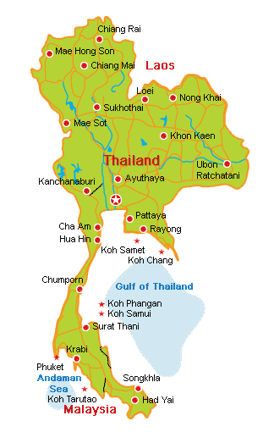
Methodology
Chiang Mai Province
390 respondents:
Communities market
Supermarket
Health food store
Agricultural Fair
Figure 2. Map of Thailand

Slide 9
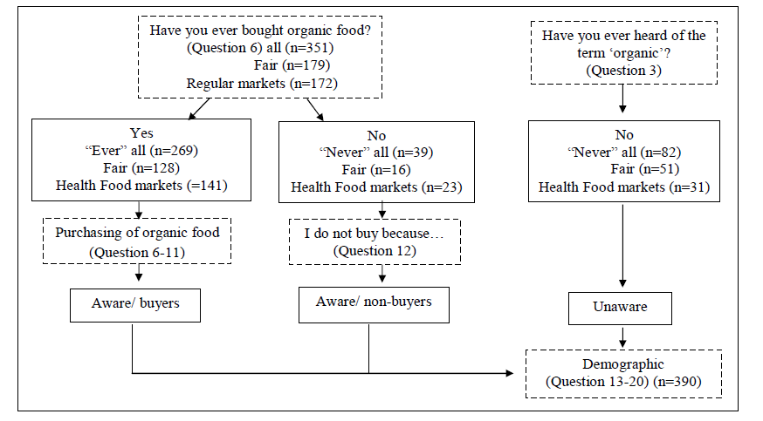
Methodology
69%
21%
10%
Figure 3. Structure of questionnaire

Slide 10
Methodology
Data Analysis
  The data was processed with SPSS 17.0
    Descriptive statistics
    Cross tabulation
    Chi-square test

Slide 11
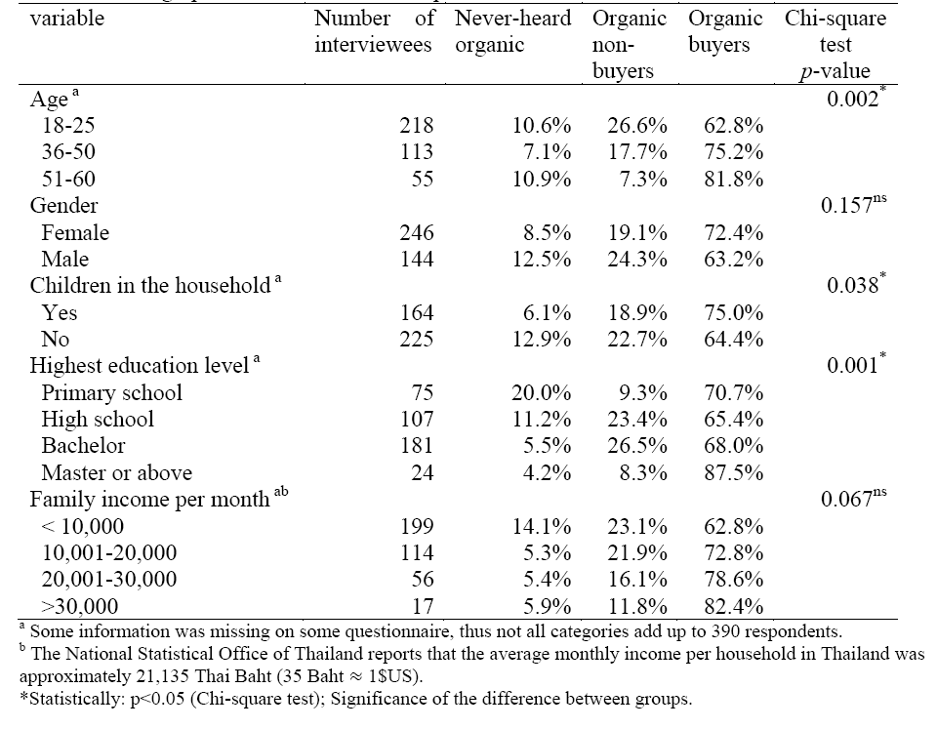
Results
Table 2. Demographic characteristics of respondents

Slide 12
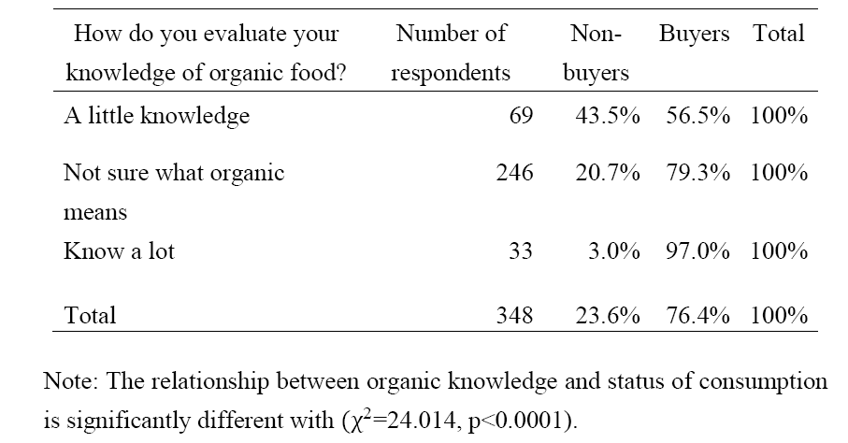
Results
Table 3. Cross tabulation of organic knowledge and consumption status

Slide 13
Results
about 31.3% of consumers recognizing the Organic Thailand (DOA) label and only less than 10% recognizing the other three organic labels (ACT, IFOAM, and NOSO; respectively)
Figure 4. Distribution of respondents by knowledge of organic labels

Slide 14
Results
Table 4. Assessment of statements about organic farming by the respondents who have heard of organic in percent (n=269)

Slide 15
Results
More than half of consumers, they said that the price of organic products are reasonable but some of consumers they said the price of organic products still expensive.
Figure 5. Consumers’ perception about price of organic products

Slide 16
Results
More than half of consumers, they are not sure about the organic labeled products.
Figure 6. Consumers’ perception about trust the organic labeled products

Slide 17

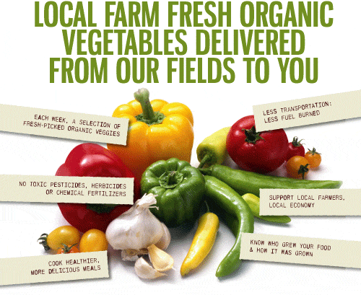
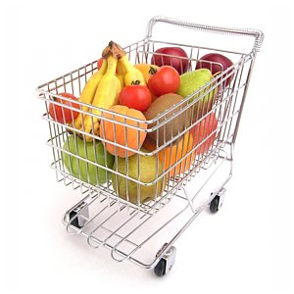

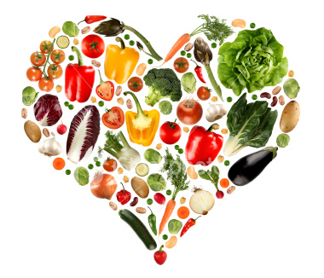


Results
consumer
Price
Information
Availability
Healthy
Environment
Support local farmers
Figure 7. Determinants of consumers for buying organic foods
http://www.google.co.th/imglanding

Slide 18
Conclusions
Almost of the respondents had already heard organic term and more than half had already bought organic products. The organic buyers in Chiang Mai City tend to have higher education and have children in household when compare with non-buyers.
The main motives to purchase organic food are health and environmental benefits, and also support local or small farmers. The main barriers to purchase organic products are the inadequate of information about organic farming method.

Slide 19
Acknowledgement
21st Annual IFAMA World Forum and Symposium
National Pingtung University Science and Technology
Department of Topical Agriculture and International Cooperation
Advisor: Dr. Huang, Wen-Chi
Thank you!!

